Slide 1

HCI - Assignment n.2
Design and prototyping of an application using a human-centered approach
Final presentation and demo
Project Title: Animal Adoption Association Webapp
Group: João 98435, Tiago Bastos 97590, Diogo 98440
Lab Class: P2
HCI 2020-2021

Slide 2
Introduction
Animal Adoption Association Webapp
We chose this theme because nowadays the abandonment of animals is increasingly common and to combat this theme we decided to create a web interface whose main objective is the adoption and help of animals.
It has no relation to any project from other disciplines
HCI 2021-2022
2

Slide 3
Project Objectives
Animal Adoption Association Webapp
High-level goals
Develop a system that allows adopting and helping animals
Allow also helping the institution that has the animals
We expect that our interface conforms to our prototype and that it has all the features we decided to implement.
This interface will bring many benefits as there is no similar web interface on the internet. It's an innovative web interface with a lot of room for progress.
HCI 2021-2022
3

Slide 4
Target Users
Animal Adoption Association Webapp
Anyone interested in adopting an animal
Anyone who finds an animal and intends to give it up for adoption or ask for help
Anyone who wants to help animals or the institution through a monetary contribution, food, medical care for the animals, among others
HCI 2021-2022
4

Slide 5

Persona 1
Name, Age, Gender Prazeres, 68 years old, Female
Job Reformed
Background She found an abandoned animal on the street and wants to take it up for adoption because she already has a lot of animals to take care of.
Problem She struggles to try to find a way to get her adopted.
Needs A system/platform that easily allows taking animals for adoption
HCI 2021-2022
5

Slide 6
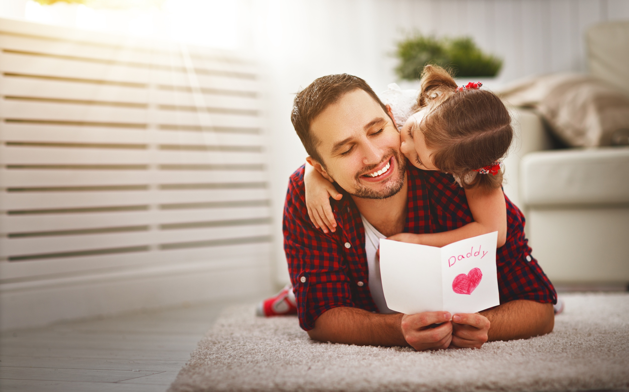
Persona 2
Name, Age, Gender João, 39 years old, Male
Job Teacher
Background His daughter wants an animal so he decided to adopt an animal
Problem He struggles to find a way to adopt an animal without having to go to an institution far from his home.
Needs A system/platform that allows you to easily adopt an animal
HCI 2021-2022
6

Slide 7

Persona 3
Name, Age, Gender Mário, 42 years old, Male
Job Businessperson
Background Every month Mário helps institutions, so he wants to donate some money to help the animals and its needs.
Problem He struggles to find a way to donate money to help the animals
Needs A system/platform that allows you to easily donate money to help the animals
HCI 2021-2022
7

Slide 8
Scenario 1
1# Ask for help for an abandoned animal found on the street
Prazeres is walking down the street until she finds an abandoned animal, extremely skinny, and takes it home so she can take it to an adoption institution.
->Without the platform, ana had to go to an adoption institution
->This way, with a few clicks, Prazeres manages to inform the institution that she has an animal for adoption and the institution travels to pick it up.
HCI 2021-2022
8

Slide 9
Scenario 2
2# Find an animal to adopt
João comes home from work and his 8-year-old daughter asks for an animal for her birthday
->Without the platform, Joao had to go to an adoption institution to adopt an animal
->This way, with a few clicks, João can choose the animal he wants and inform the institution of his choice
HCI 2021-2022
9

Slide 10
Scenario 3
3# Donate Money to Help the Animals
Mário comes home from work after he has received his salary. Being a person who likes to help institutions, he decides to donate some money for the animals.
->Without the platform, Mário doesn't know where to donate the money for the animals.
->This way, with a few clicks, Mário manages to donate some money to the institution, so the institution use the money for all the animals and its needs.
HCI 2021-2022
10

Slide 11
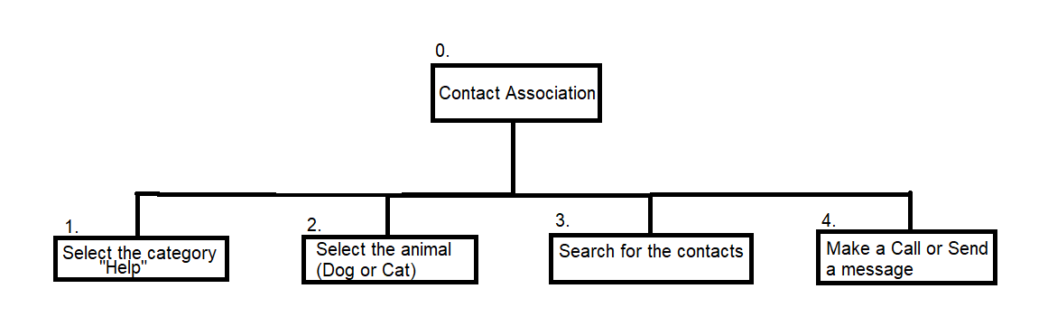
Tasks
1# Ask for help for an abandoned animal found on the street
HCI 2021-2022
11

Slide 12
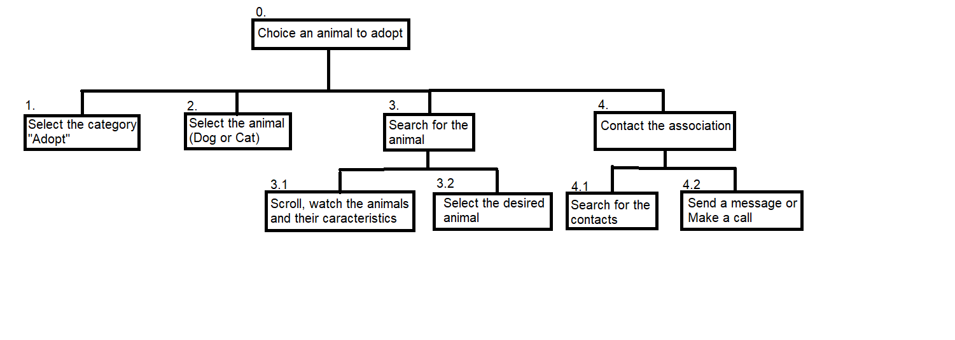
Tasks
2# Find an animal to adopt
HCI 2021-2022
12

Slide 13
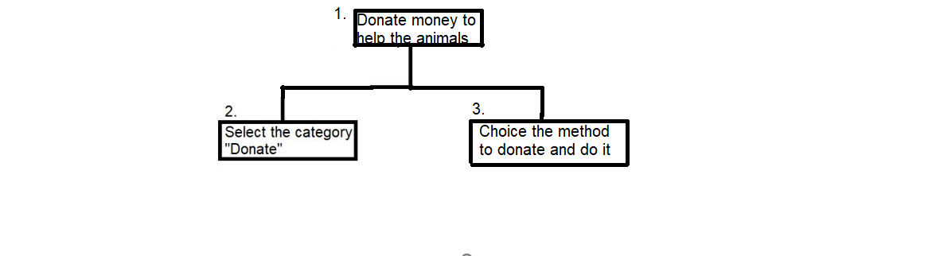
Tasks
3# Donate Money to Help the Animals
HCI 2021-2022
13

Slide 14
Requirements
Animal Adoption Association Webapp
Non-functional requirements
Design must be simple, intuitive and easy learning
Appealing Interface
Easy access
Application must be persistent
Functional Requirements -
Any user should be able to search for any animal to adopt and watch all the animal caracteristics
Users should be able to help the animal adoption association by donating money
Should be possible to deliver an abandoned animal or ask for help.
HCI 2021-2022
14

Slide 15
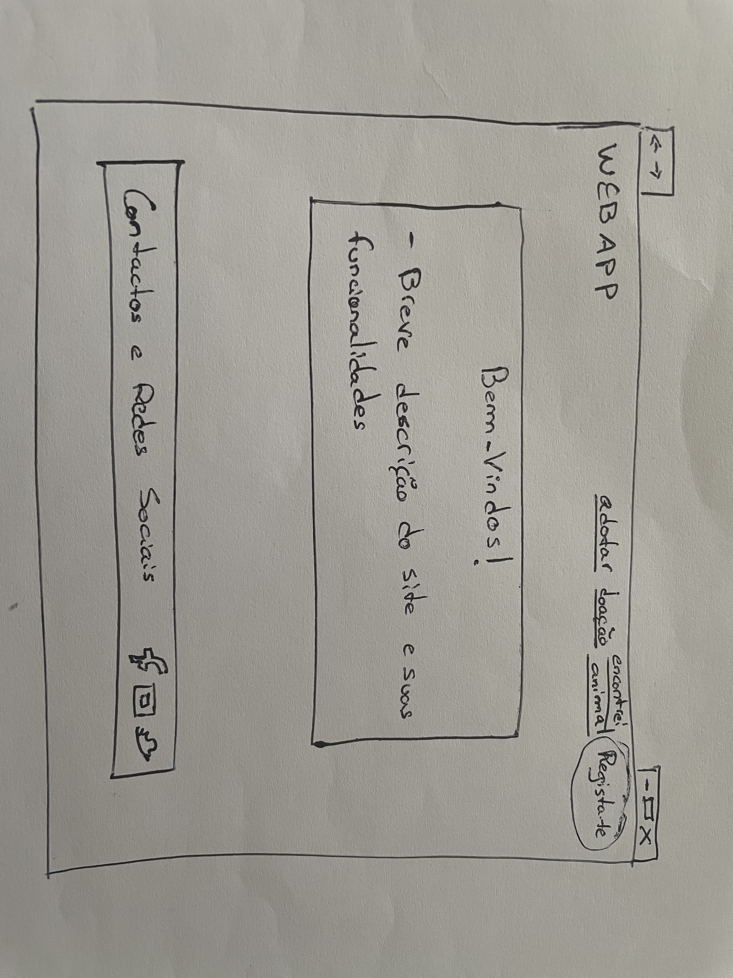
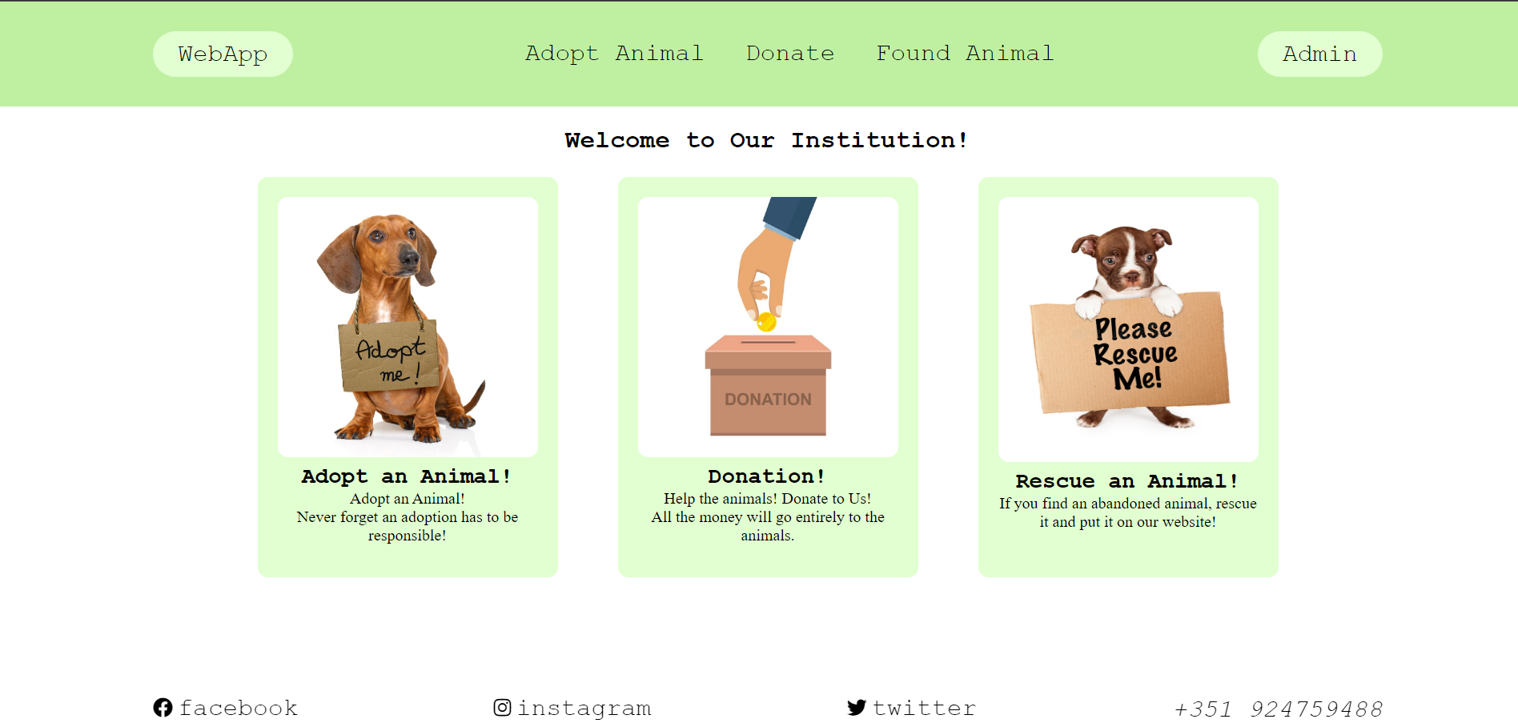
Low Fidelity Prototype (LFP)
Animal Adoption Association Webapp
The low fidelity prototype was developed in paper!
HCI 2020-2021
15
Notes:
This is new material; should be presented in more detail

Slide 16
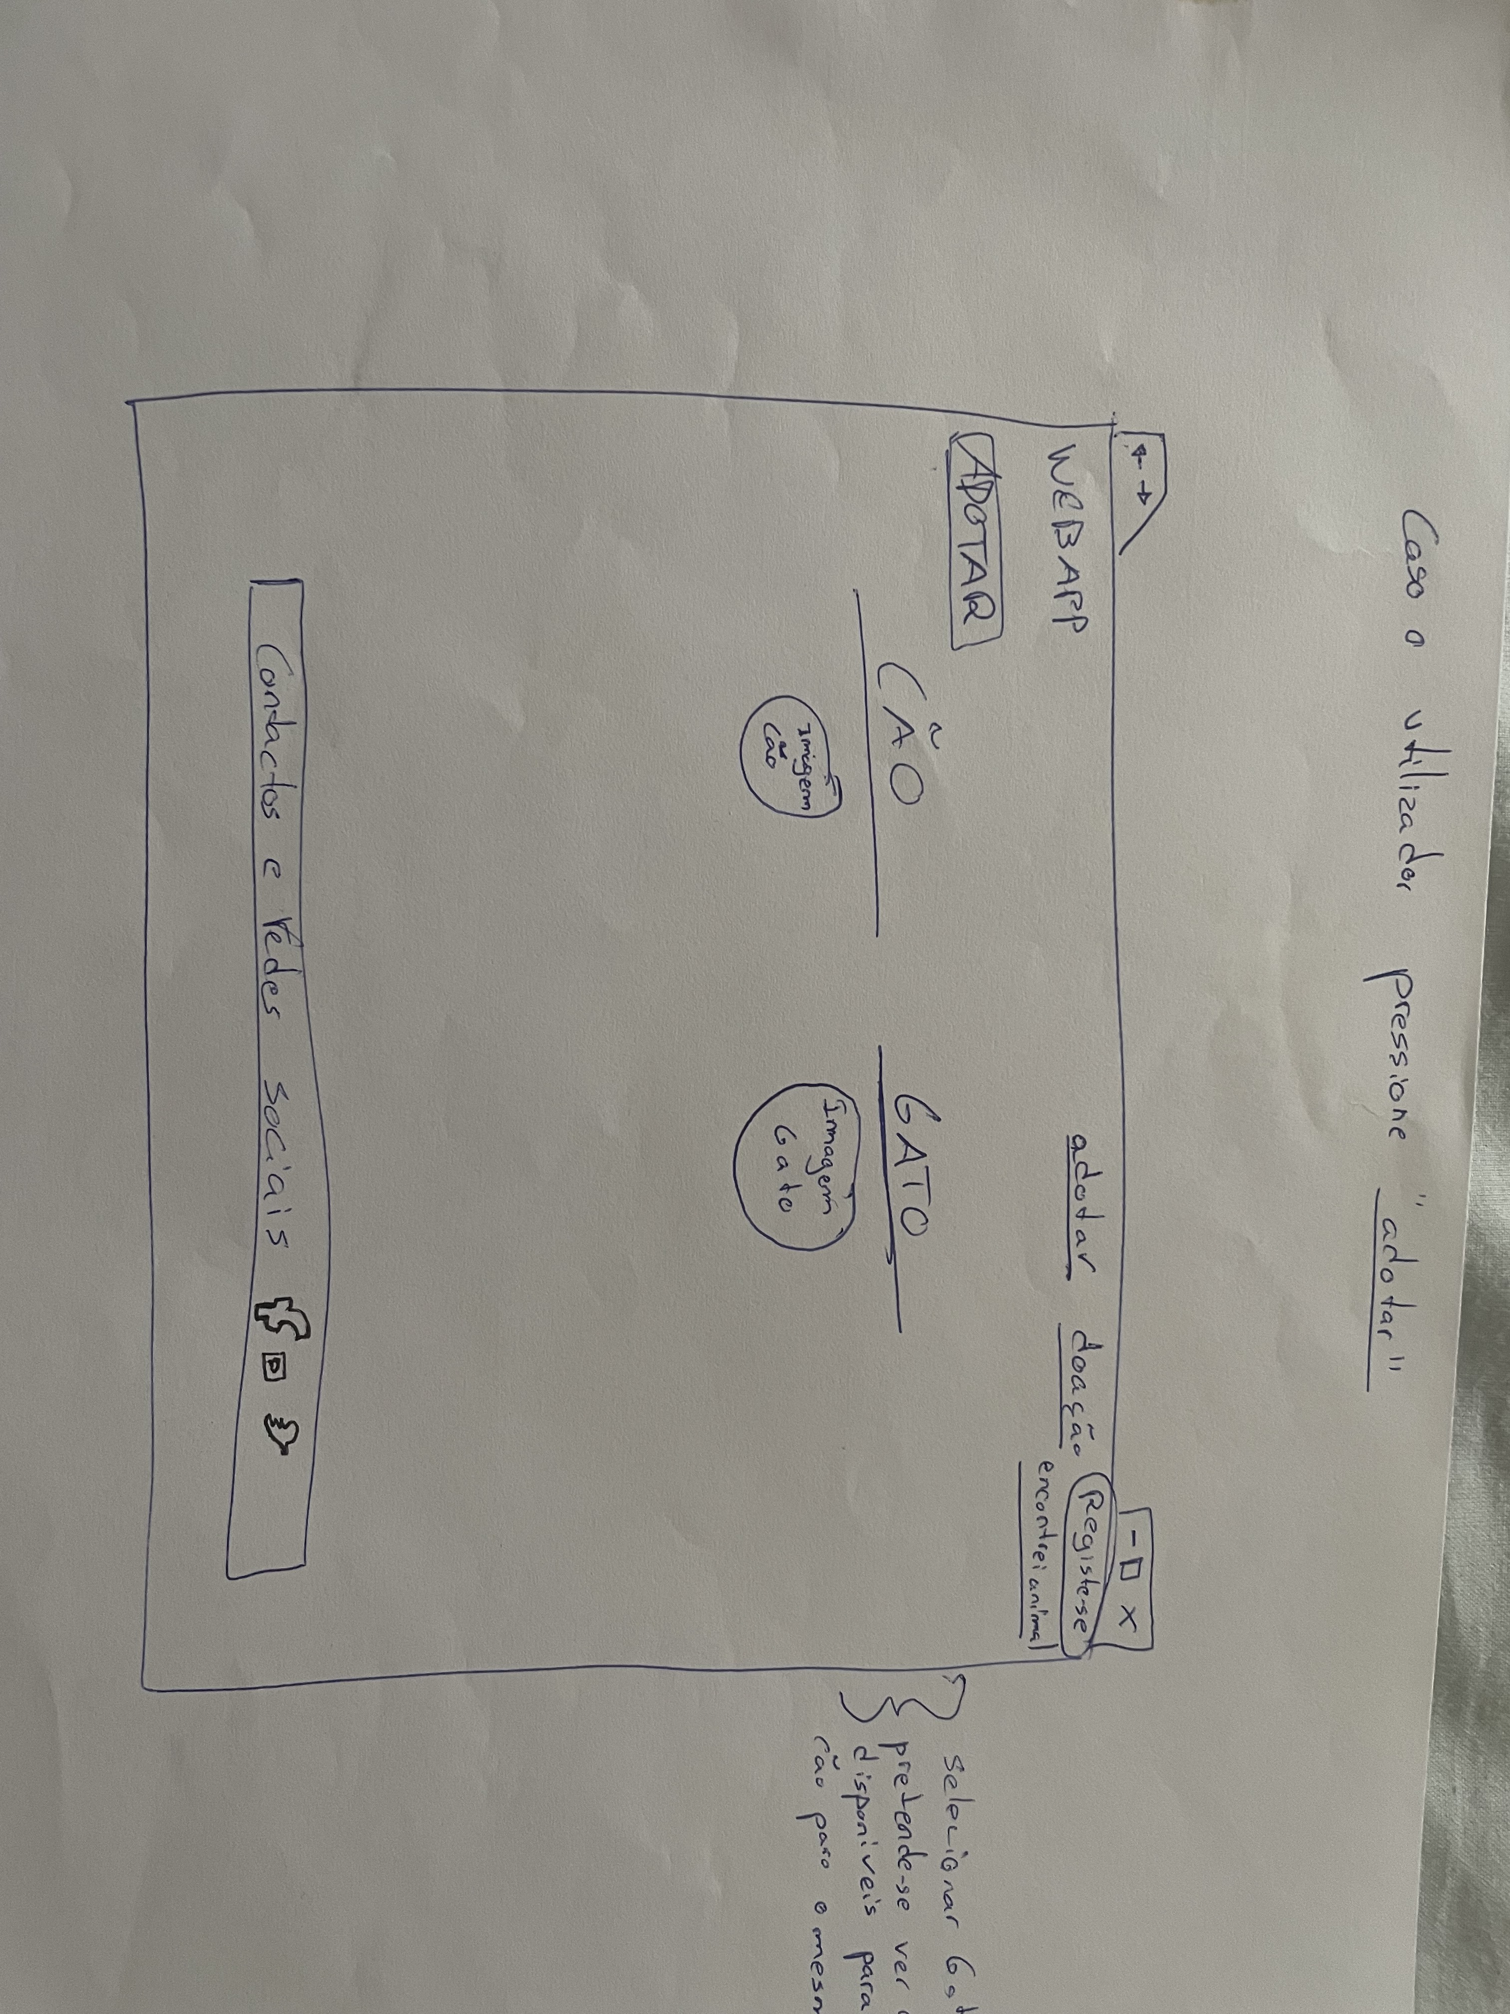
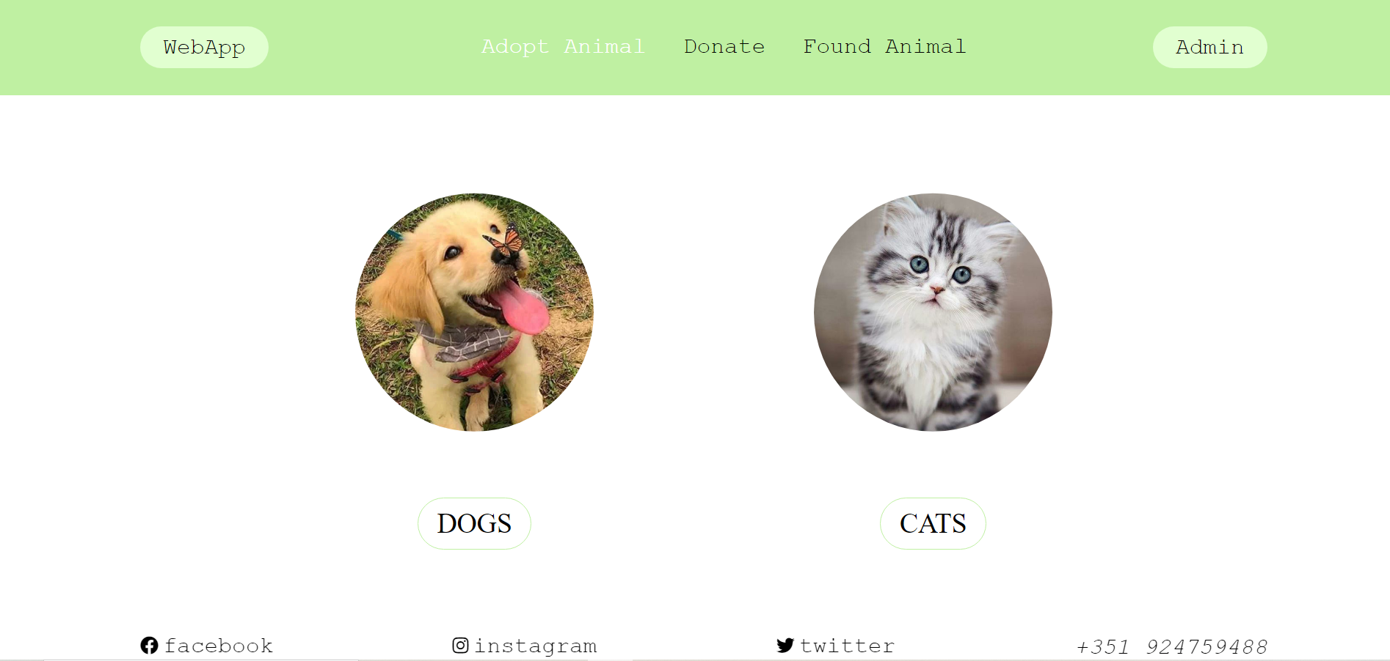
Low Fidelity Prototype (LFP)
Animal Adoption Association Webapp
HCI 2020-2021
16
Notes:
This is new material; should be presented in more detail

Slide 17
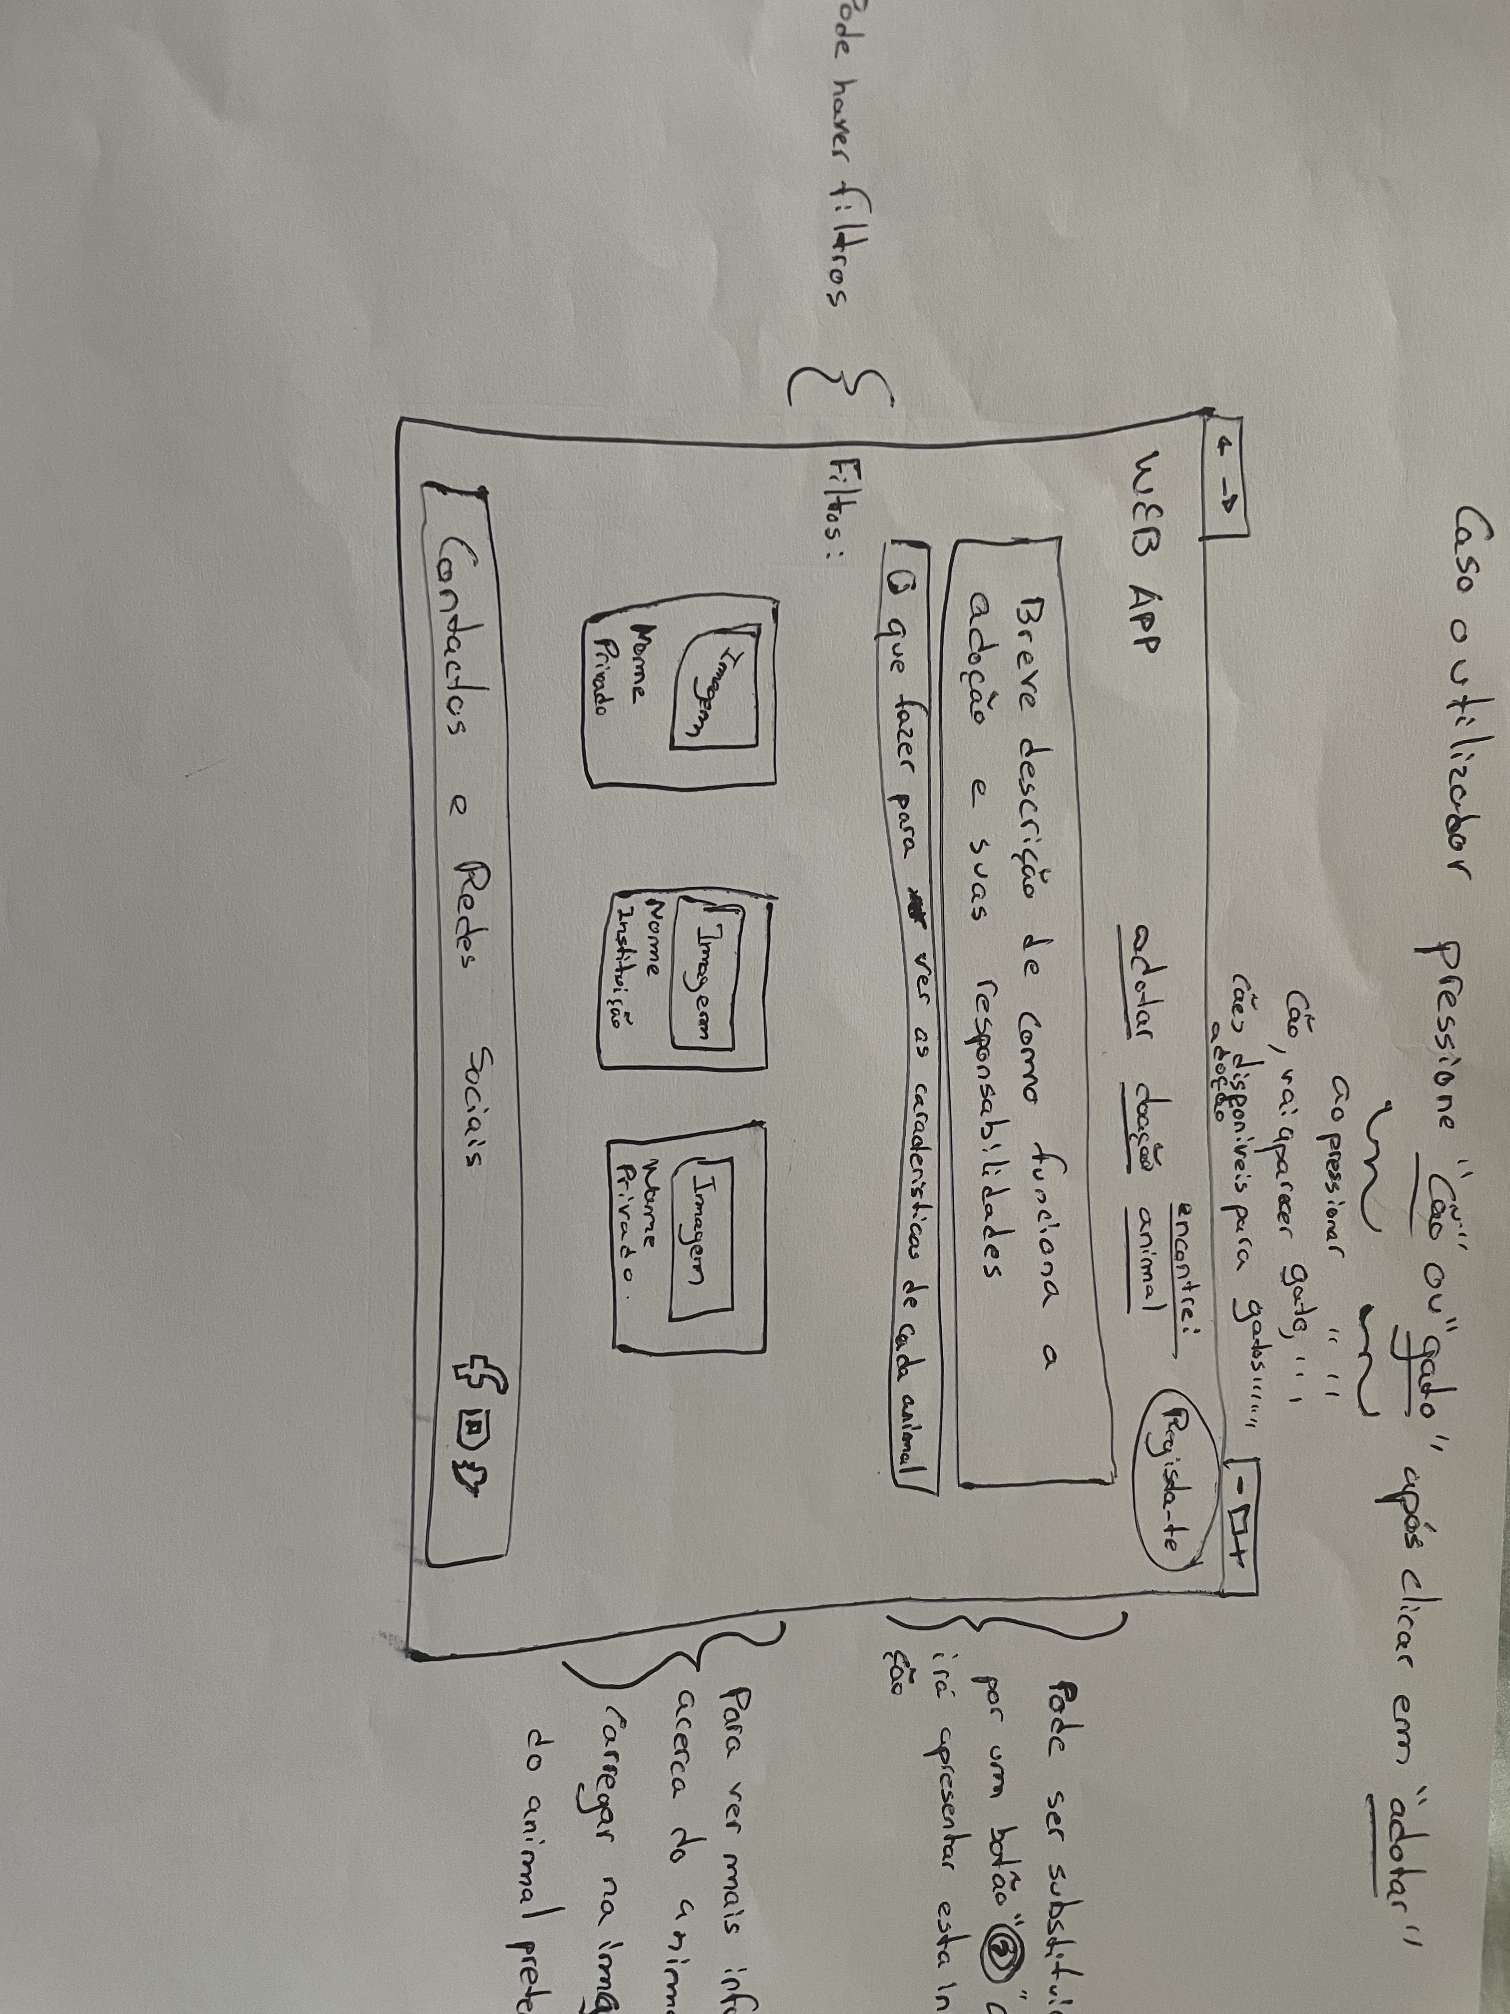
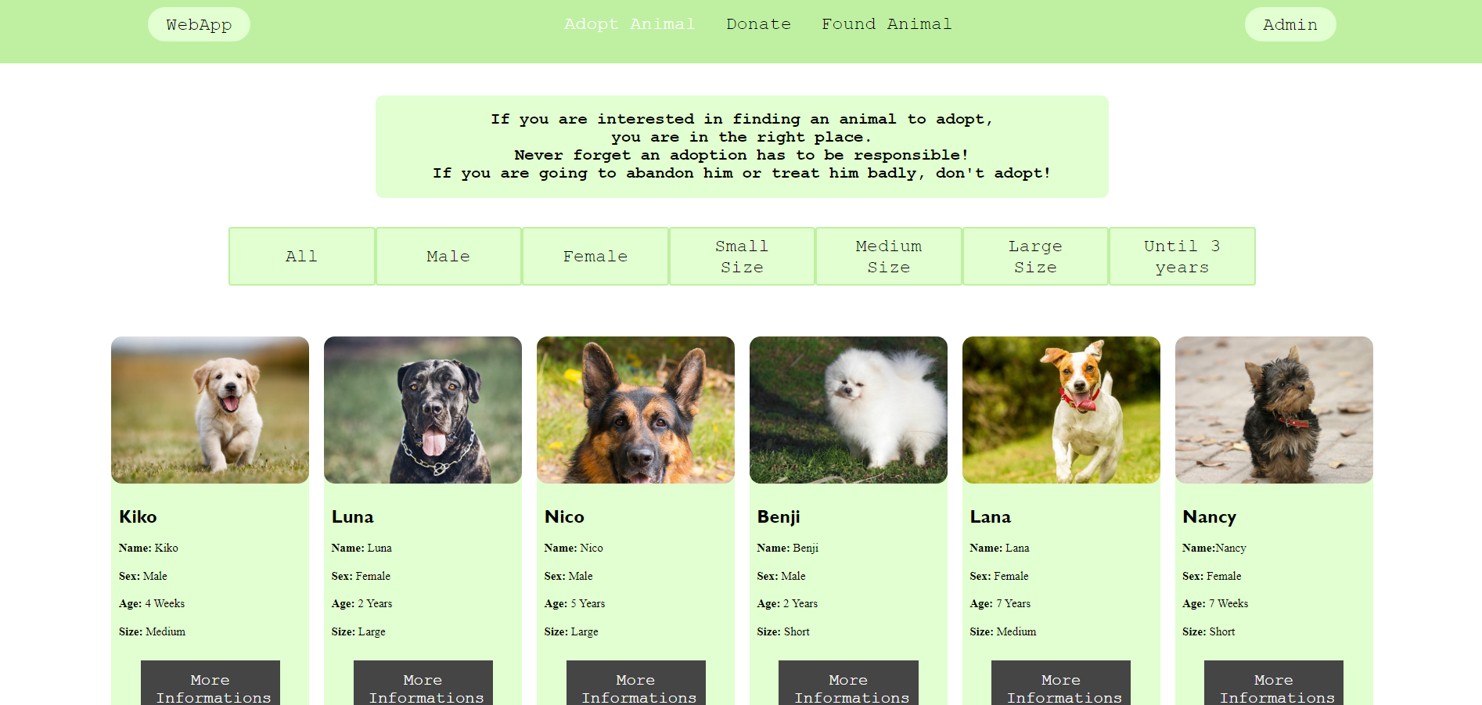
Low Fidelity Prototype (LFP)
Animal Adoption Association Webapp
HCI 2020-2021
17
Notes:
This is new material; should be presented in more detail

Slide 18
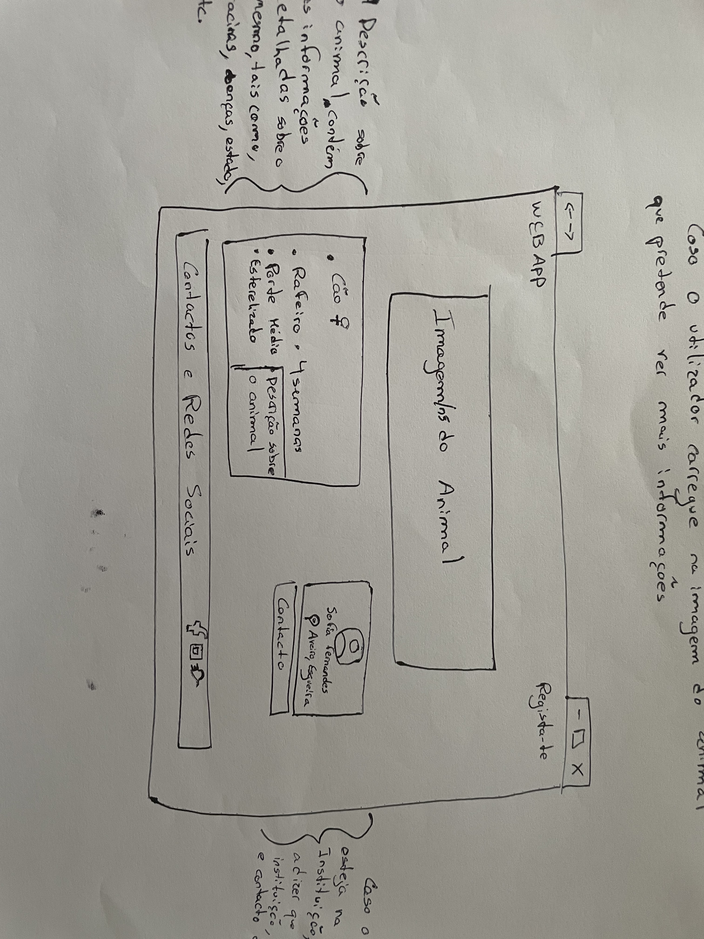
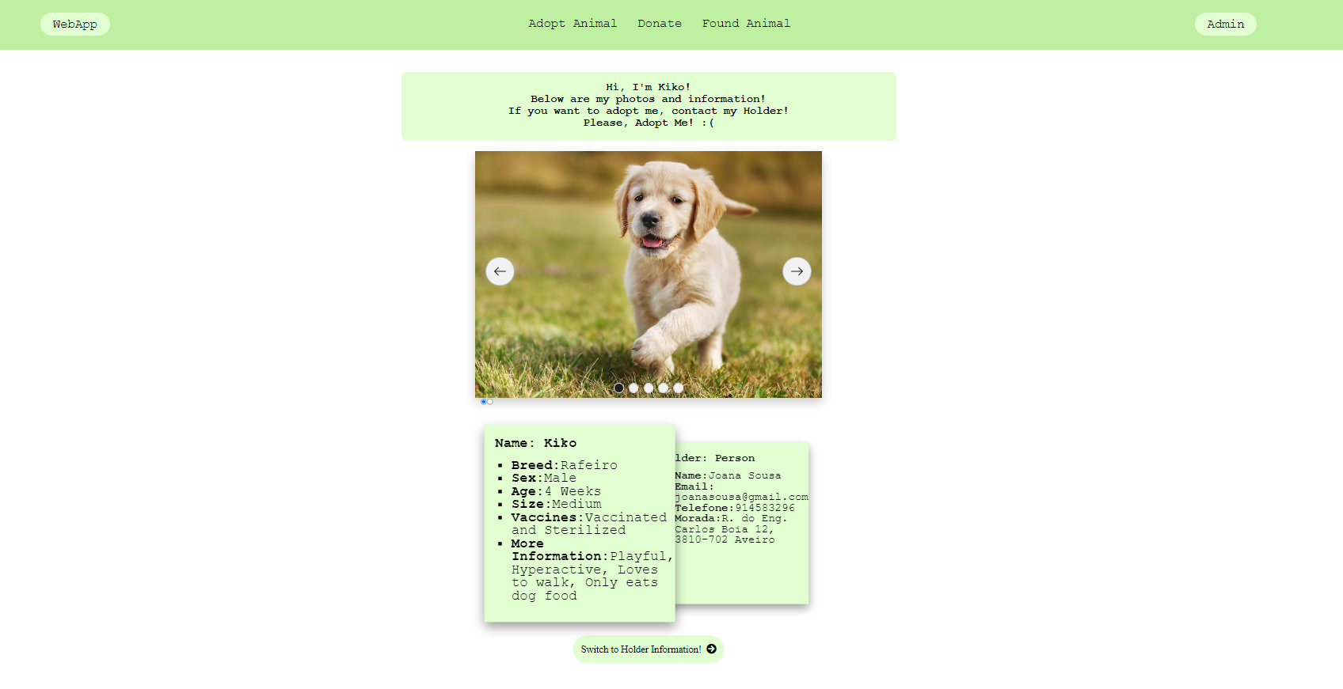
Low Fidelity Prototype (LFP)
Animal Adoption Association Webapp
HCI 2020-2021
18
Notes:
This is new material; should be presented in more detail

Slide 19
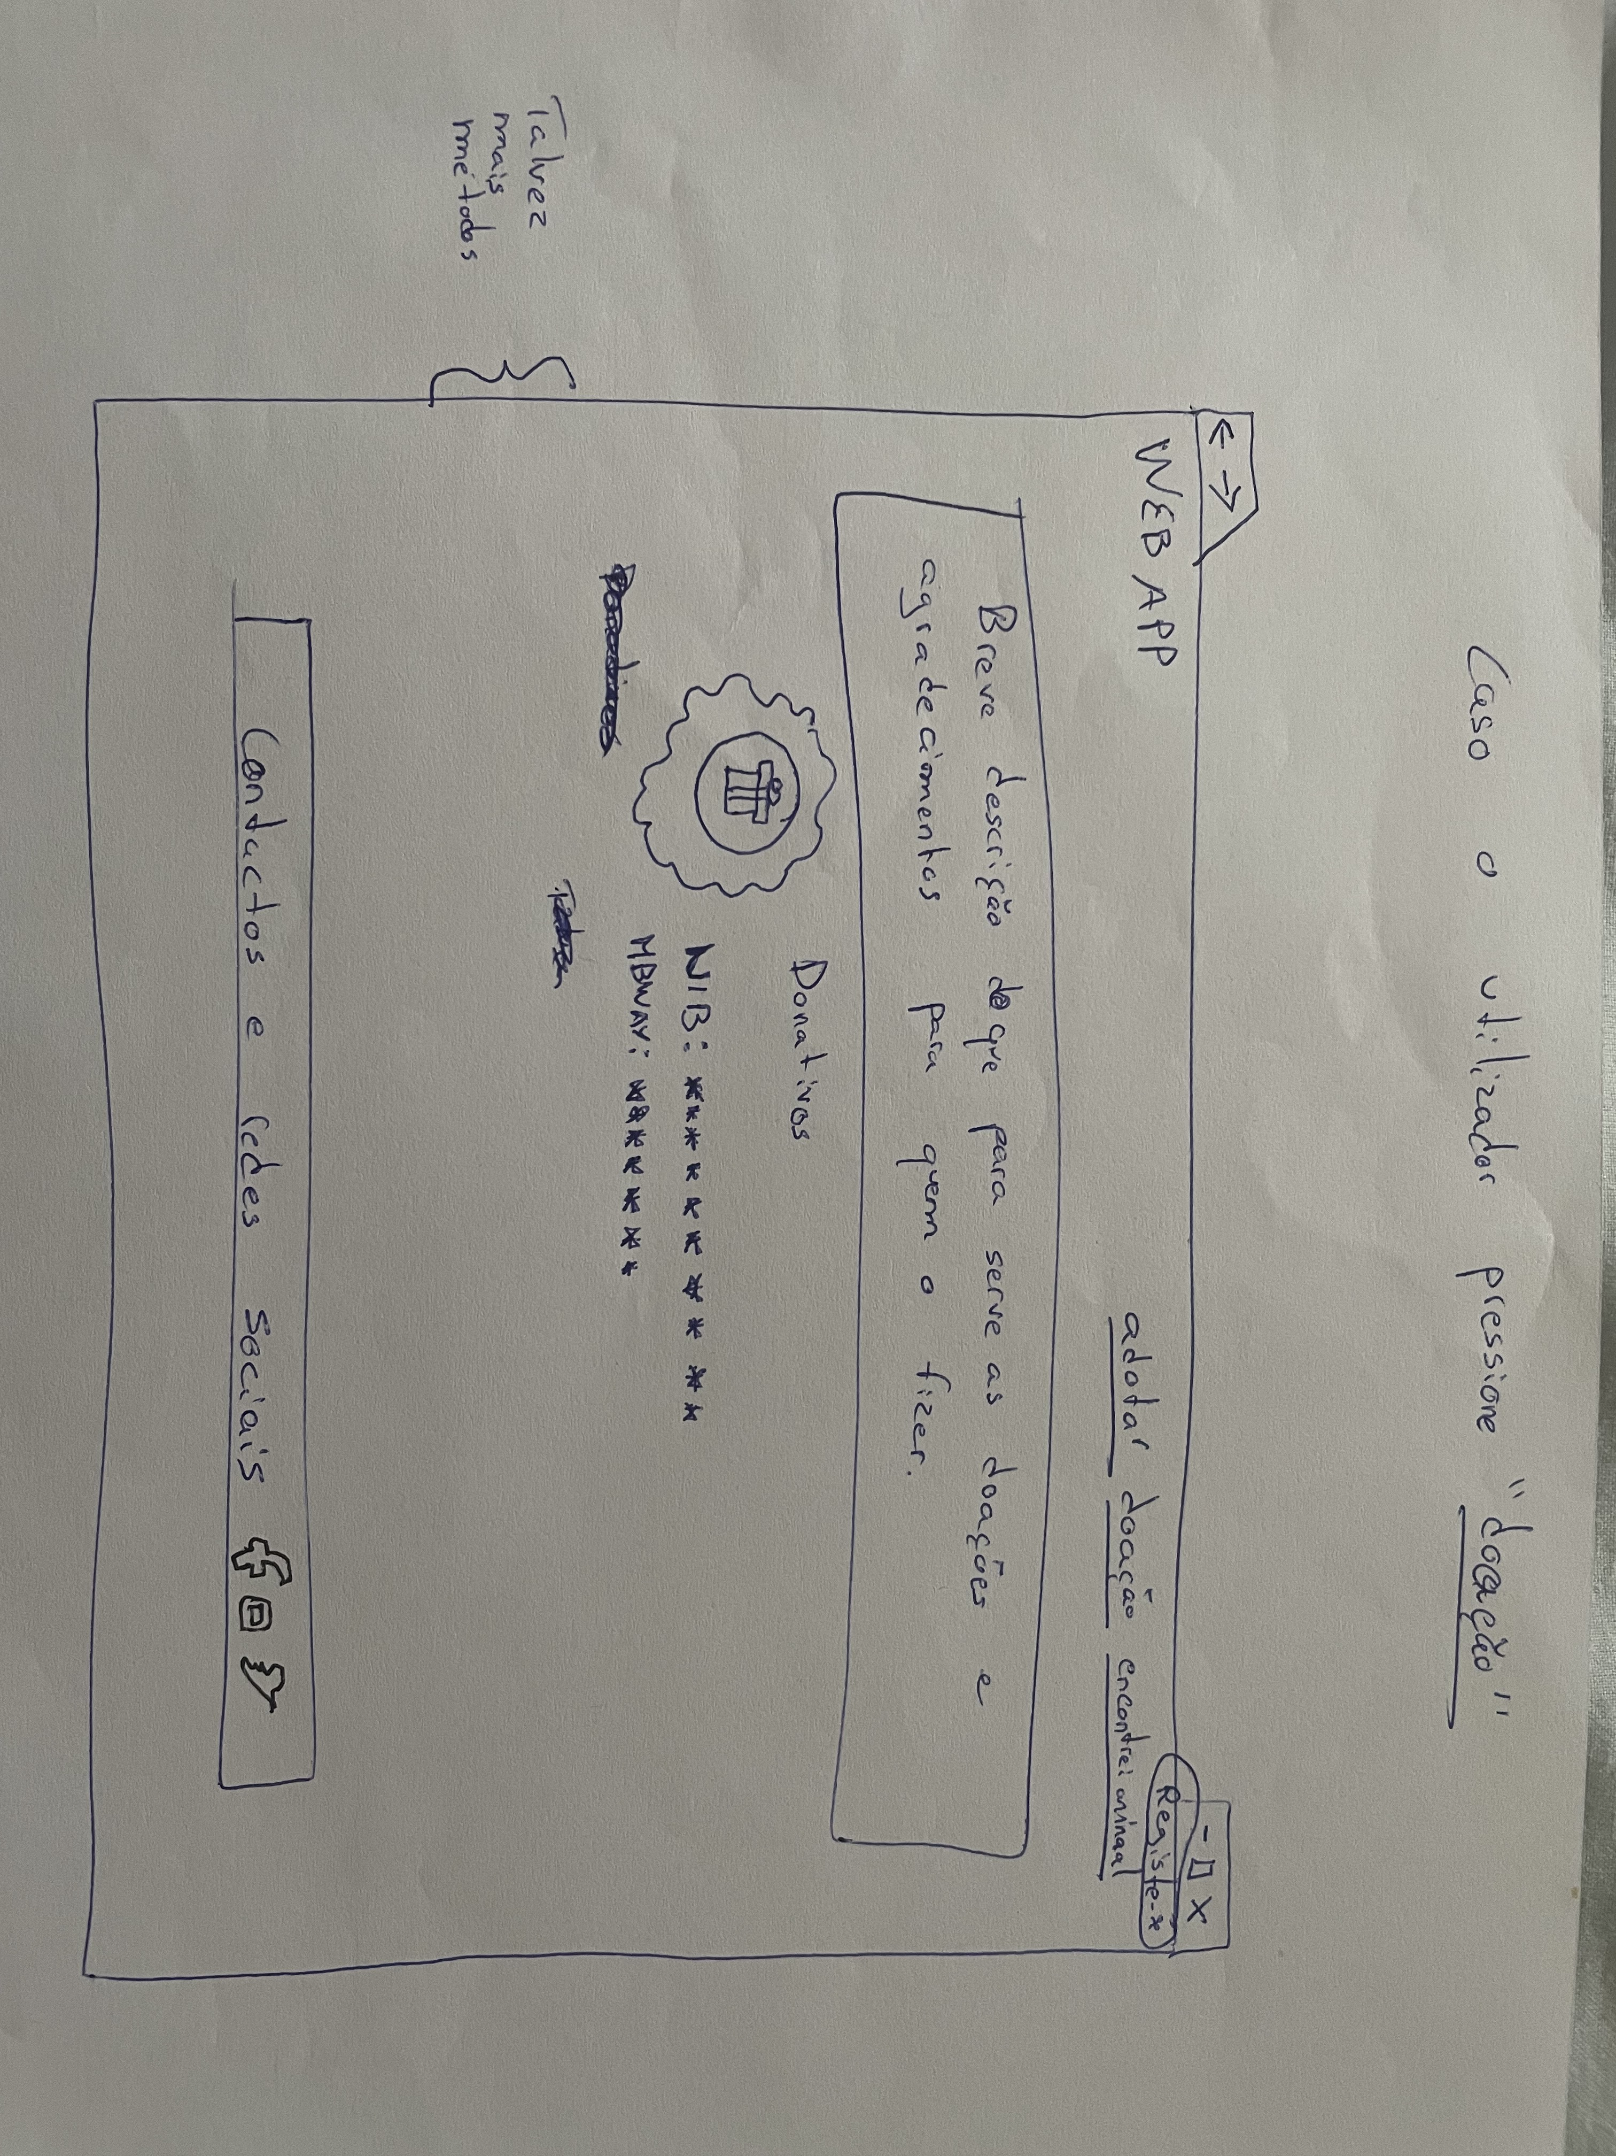
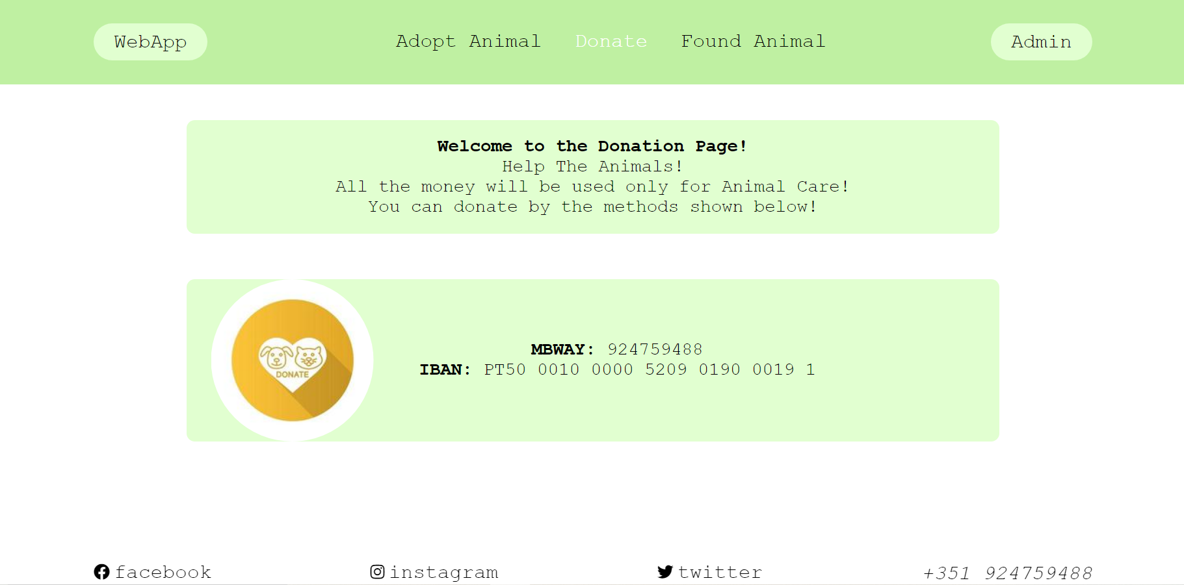
Low Fidelity Prototype (LFP)
Animal Adoption Association Webapp
HCI 2020-2021
19
Notes:
This is new material; should be presented in more detail

Slide 20
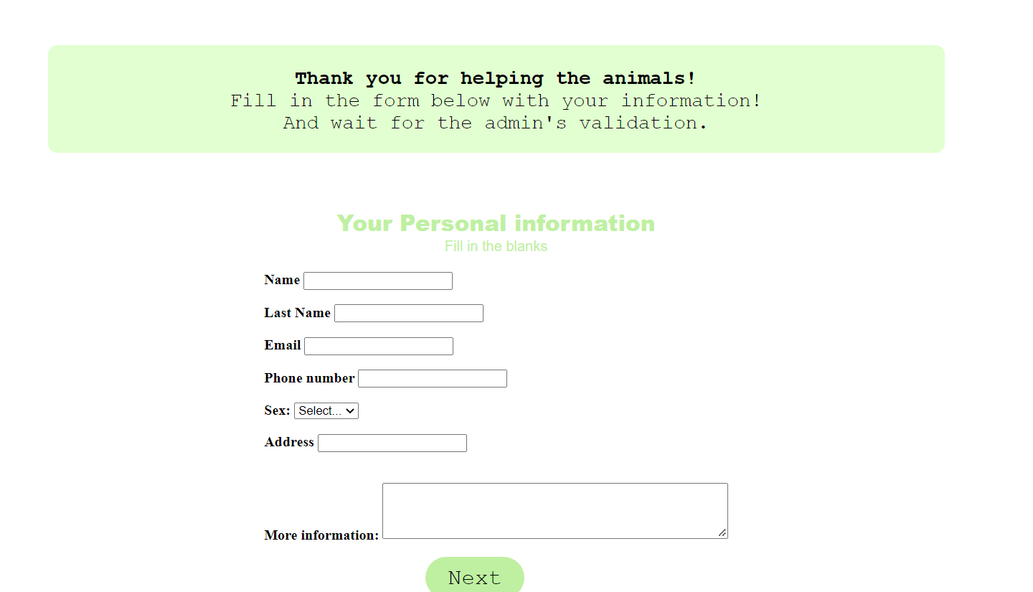
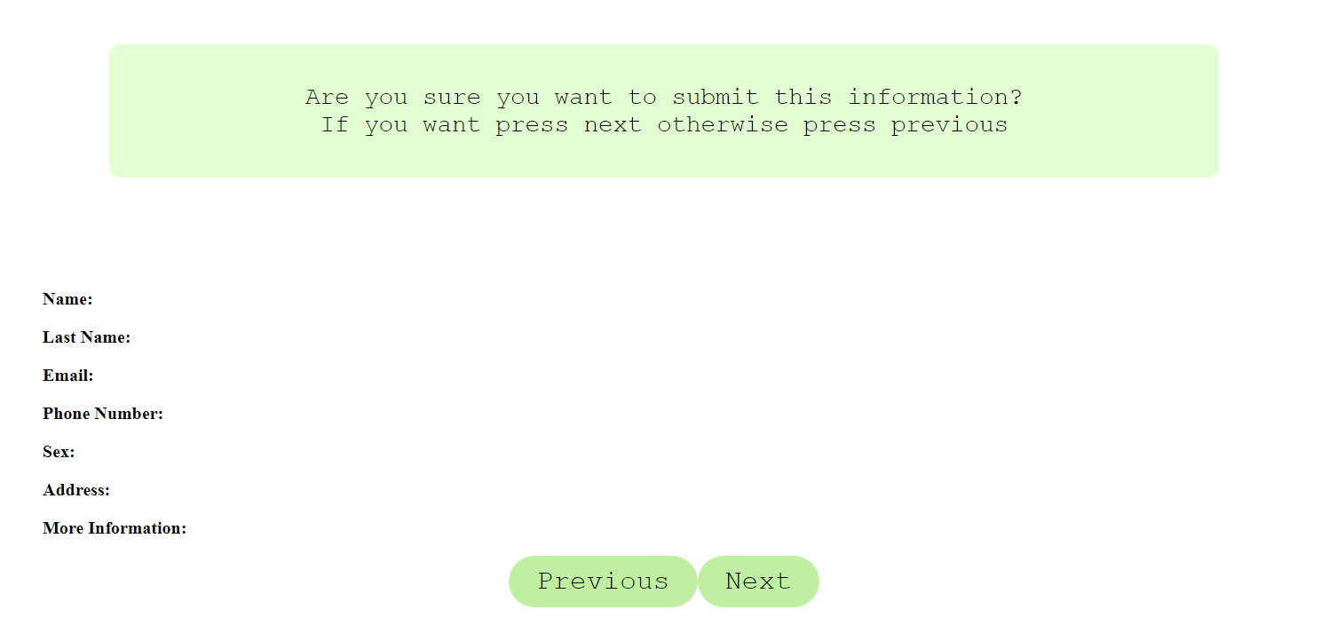
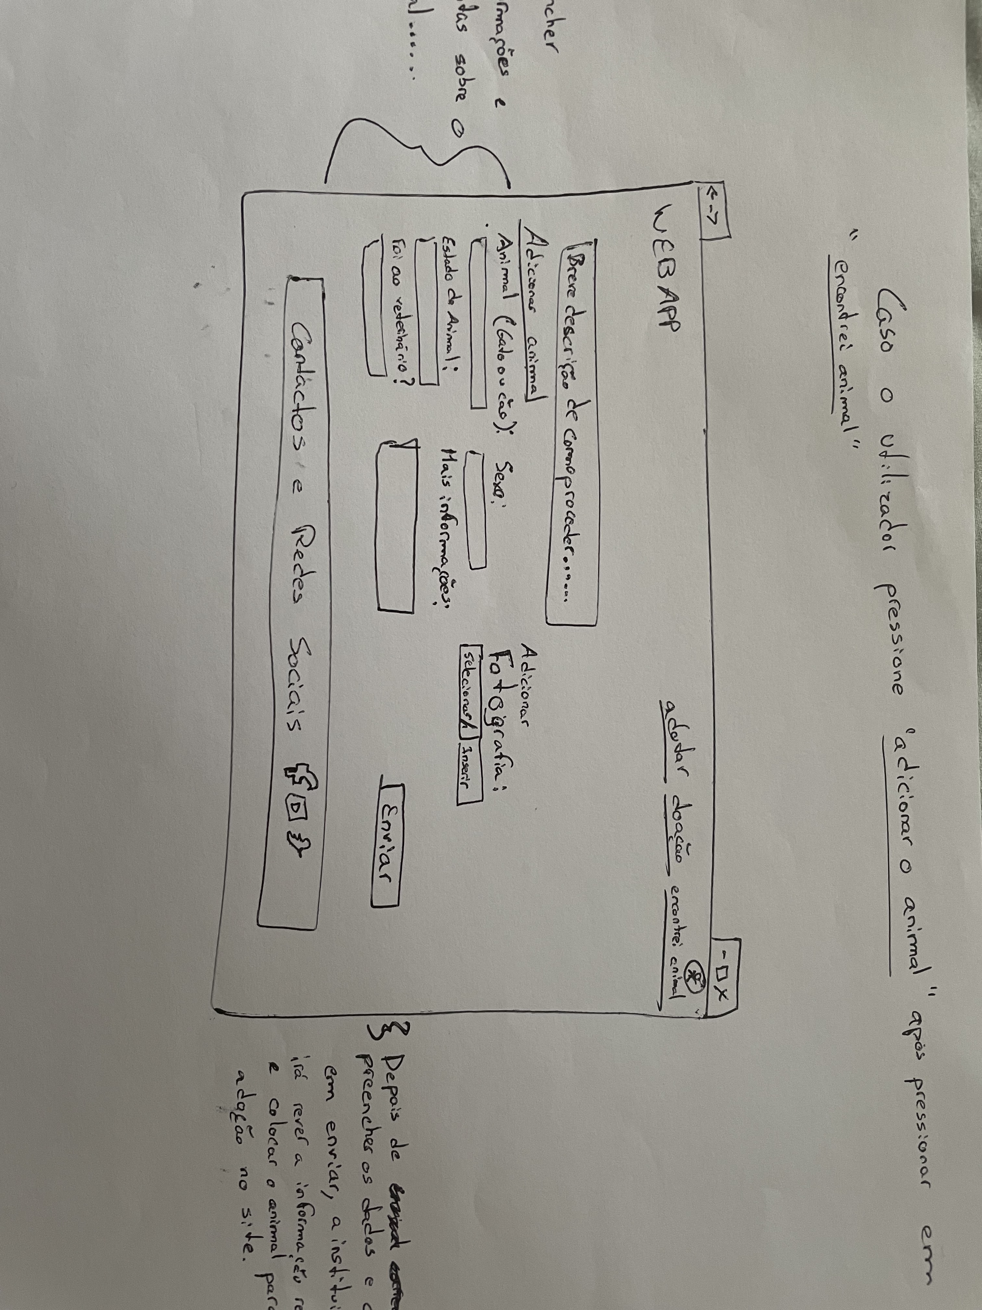
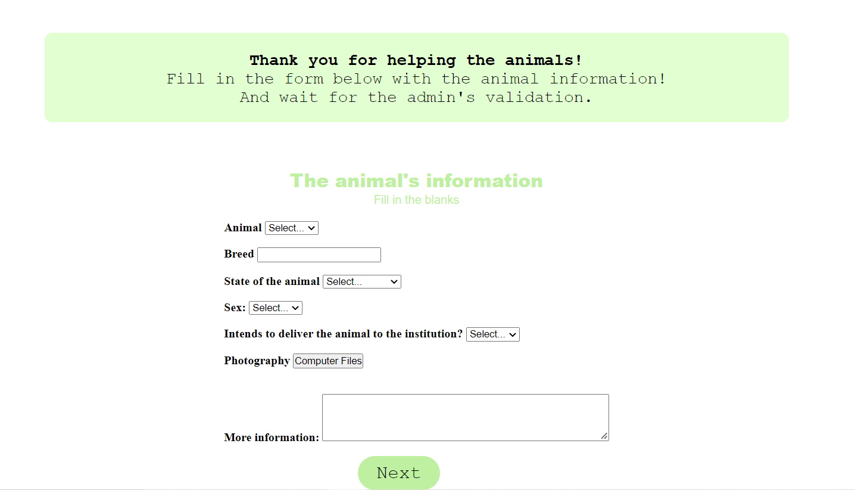
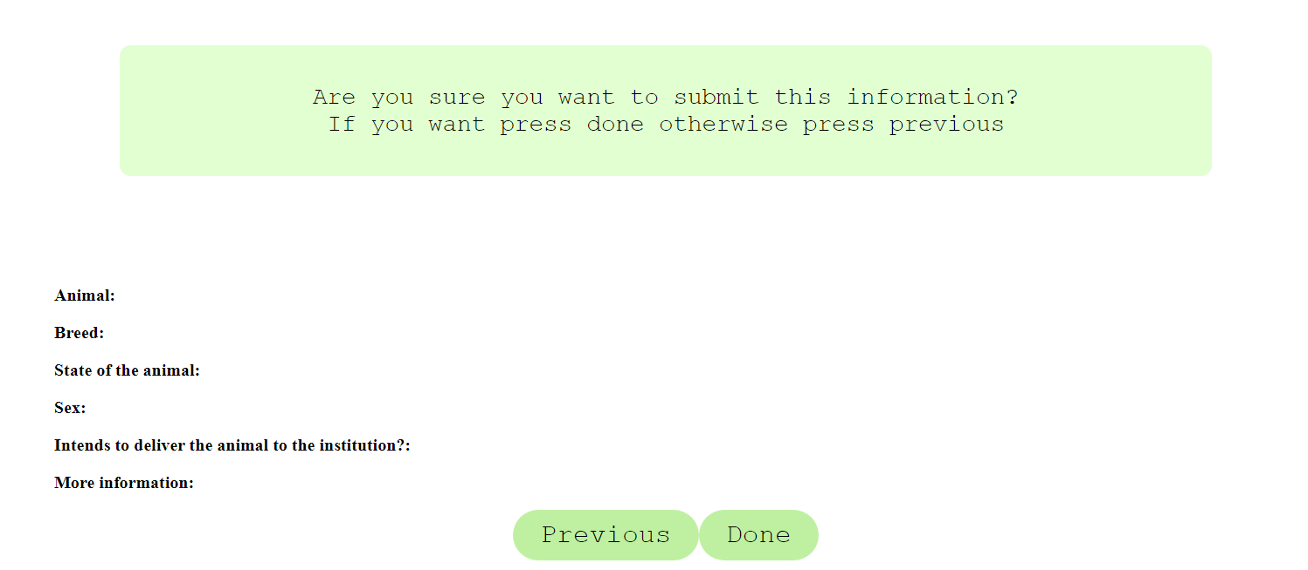
Low Fidelity Prototype (LFP)
Animal Adoption Association Webapp
HCI 2020-2021
20
Notes:
This is new material; should be presented in more detail

Slide 21
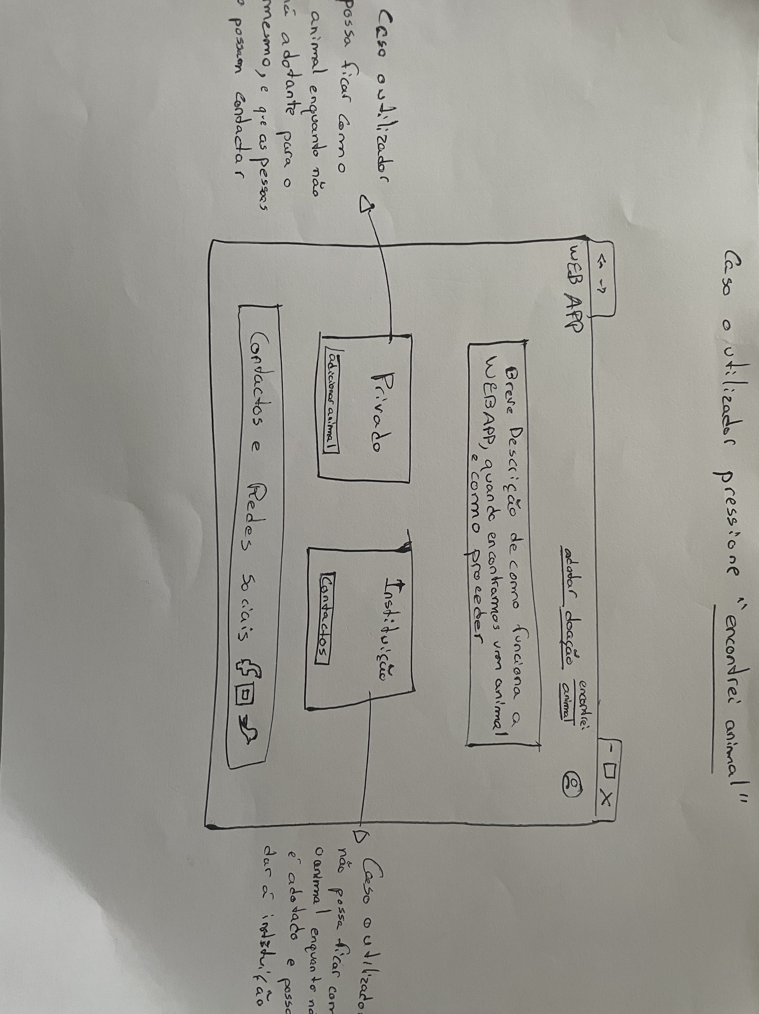
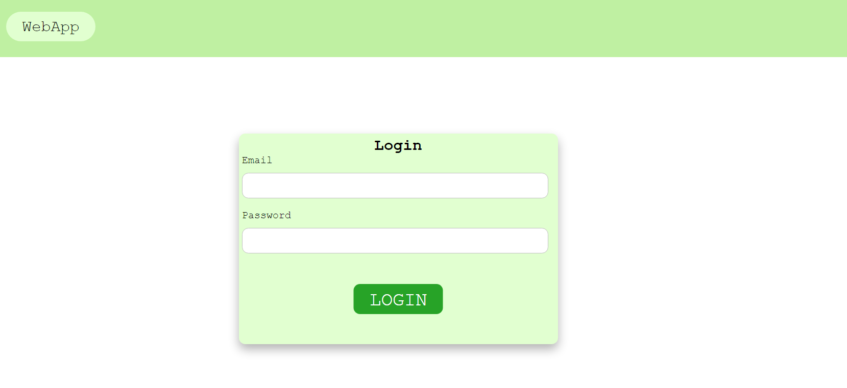
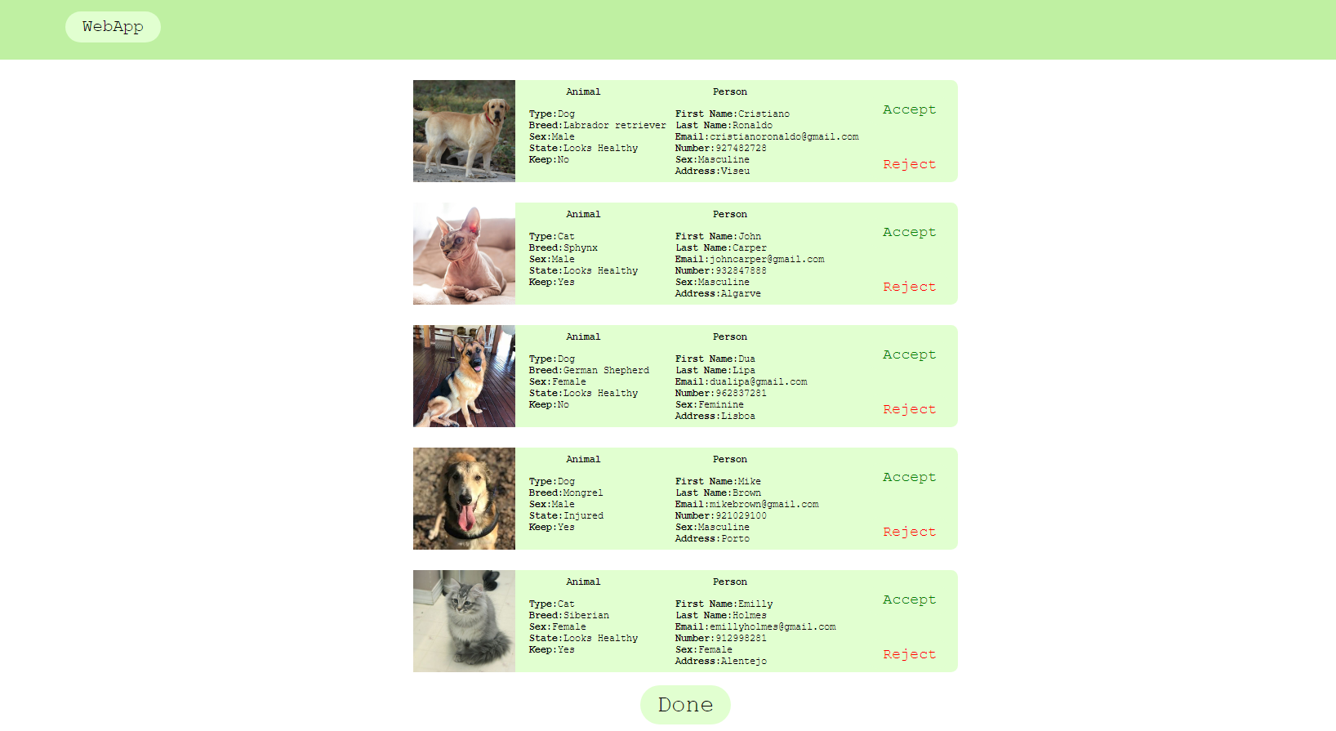
Low Fidelity Prototype (LFP)
Animal Adoption Association Webapp
Page Removed:
Pages Added:
HCI 2020-2021
21
Notes:
This is new material; should be presented in more detail

Slide 22
LFP User Evaluation
Animal Adoption Association Webapp
The main goal was to evaluate the 3 personas and the scenarios developed
previously.
Tasks?
Put the animal found on the street for adoption on the webapp
Adopt an animal
Donate money
All personas and scenarios were addressed
All tasks were used
6 users 5 students 1 teacher
Present the main results
The login page was removed and a page was created for the administrator to validate the animals inserted
The page where the user choose whether to keep the animal or give it to the institution was removed and that information was entered in the form to be filled in, to insert an animal for adoption
On the adopt page we added the most important information for each animal card in order to facilitate the choice
HCI 2020-2021
22

Slide 23


Platform Used for the functional prototype
Animal Adoption Association Webapp
React.
We selected this technology because it was the proposed solution.
We choose Web Application over mobile app because the actions and tasks would fit better in the Web Application.
HCI 2020-2021
23

Slide 24
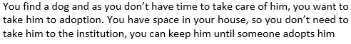
User Evaluation of the functional prototype
A functional prototype was developed in React.
The main goal was to evaluate its usability.
All scenarios and all personas were addressed
We used four tasks for the evaluation:
Task1 -
Task2-
Task3-
Task4-
HCI 2020-2021
24

Slide 25
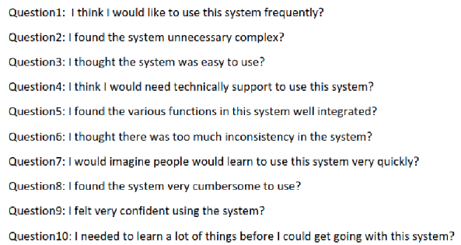
User Evaluation of the functional prototype
The user evaluation included 6 participants
From those 6, 5 were students
From those 6, 1 was the teacher
What questionnaires where used?
After all tasks were completed, each user answered a set of a questions, rated from 1 to 5:
HCI 2020-2021
25

Slide 26
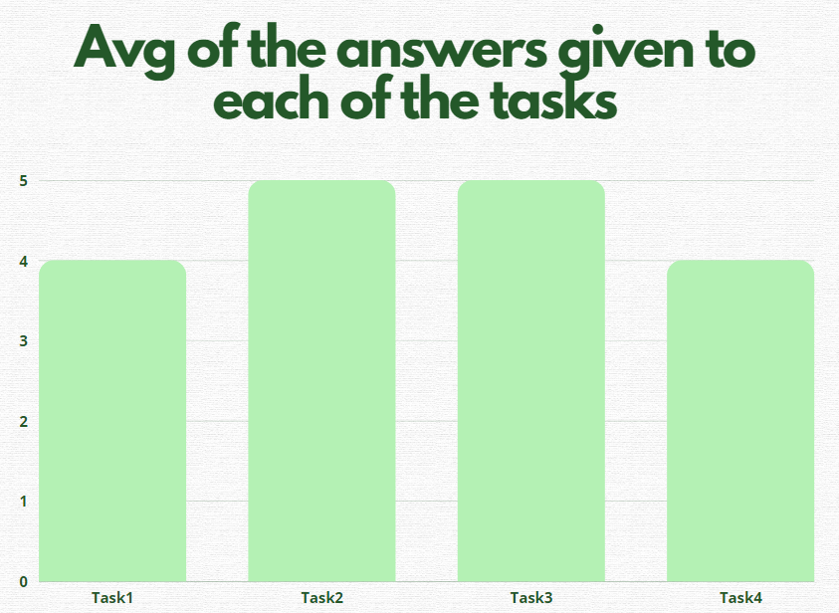
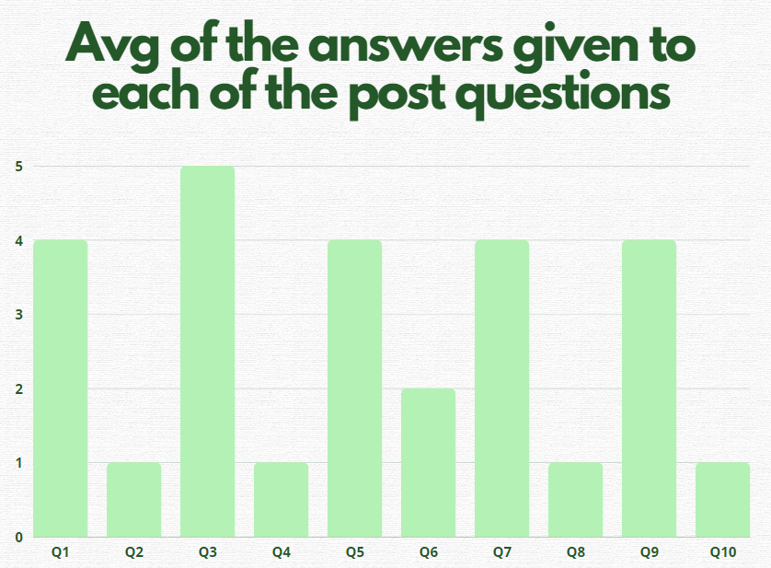
User Evaluation of the functional prototype
HCI 2020-2021
26

Slide 27
User Evaluation of the functional prototype
Results (specific tips given):
Not allowing the user to change the submitted information and go back after submitting the form, could be a problem
On the donations page, information about the page was more prominent than the payment methods themselves
On the home page, the images were not all the same size, there was a lot of text and there were no titles
HCI 2020-2021
27

Slide 28
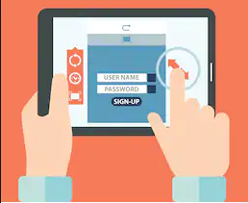
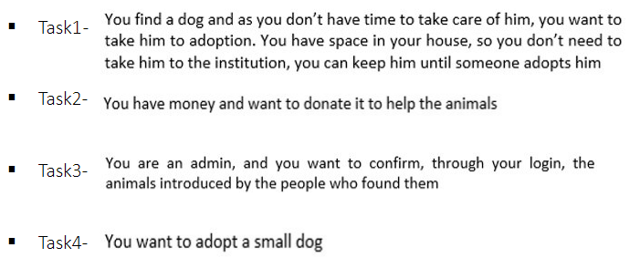
Demo
Animal Adoption Association Webapp
HCI 2020-2021
28

Slide 29
Future work
Improve animal filters (e.g. sort ascending by age ) and add others.
Build a strong and persistent backend.
Improve frontend based on user feedback.
Add new functionalities.
Test everything with new user tests.
Effort of each group member
Diogo Torrinhas – 33%.
João Torrinhas – 33%.
Tiago Bastos – 33%.
HCI 2020-2021
29

Slide 30
Acknowledgments
We would like to acknowlegde all the participants that participated and gave us feedback on the two tests of our low fidelity prototype and of the functional prototype.
Bibliography
HCI 2020-2021
30

